Slide 1

A Project presentation on “Learning Models for Predicting Ranks”
Presented by Batch No.: INT-B-MT-27
MANTHRI NANDINI 19121A05D7
MARUBOYINA POOJITHA 19121A05D8
M NIKHIL KUMAR REDDY 19121A05D9
MAVILLA PRAVALLIKA 19121A05E0
Computer Science and Engineering
Under the Guidance of
Dr. A.V. Sriharsha
Professor
Dept. of CSE

Slide 2
CONTENTS
Abstract
Introduction
Statement of the problem
Objectives
Software and hardware requirements
Existing System
Software Requirement Document
Proposed System
Algorithm or approach used
Design
References

Slide 3
Abstract
The rankings are provided yearly so the analysis of data that Provided by the Institution and various Other Sources. There Should be a Learning model for predicting Ranks Since the Parameters are changing in a rapid manner where the Statistical model fails. So There Should be a Learning model to overcome the drawbacks of Rigid way of Computation. This Project intends to build a model for NIRF Rank prediction with interactive visualization of ranking parameters and also suggests the areas where the institution should be focused to achieve for attaining the standards fixed by the National Institutional Ranking Framework (NIRF). The parameters broadly cover “Teaching, Learning and Resources”, “Research and Professional Practices”, “Graduation Outcomes”, “Outreach and Inclusivity”, and “Perception”. The progress in the Parameters signs the improvement of the Quality of Educational Institutions in the country.

Slide 4
Introduction
To outline the Brand value of a specific College in India, the Concept of NIRF Ranking Parameters was introduced by the Ministry of Human Resource & Development (MHRD) on 29th September 2015. The main idea behind the National Institutional Ranking Framework (NIRF) is to outlines a methodology to rank institutions across the country. The Ministry of Education’s National Institutional Ranking Framework (NIRF), which provides access to statistical databases and reputation surveys to generate national league tables, is primarily responsible for the Indian national university ranking system. This system contains a more comprehensive collection of factors due to their access and in-depth understanding of institutions.

Slide 5
Problem Statement
Build a Learning Model for Predicting Ranks of various organization based on the Standards followed by various Ranking Organisation unlike the Rigid System which follows the statistical Models.

Slide 6
Objectives
To Predict the Ranks of various Institutions using the Learning Model using the advance technologies where the Conventional System Fails.
The main idea behind the National Institutional Ranking Framework (NIRF) is to outlines a methodology to rank institutions across the country.
One of the key factors influencing students for enrollment.
Helps institutes to take measures for improving the performance.
Encourages the institutes to work harder to provide quality education.

Slide 7
Software and hardware Requirements
Python Environment above 3.6
FastAPI
SKLearn
Keras
Seaborn for Visualization.

Slide 8
Existing System
Evaluates the Rank based on the given parameters.
Algorithms used :
Logistic Regression
K-Nearest Neighbours
Decision Tree

Slide 9
Software Requirement Specification
Our Ranking System Should meet the following requirements:
Functional Requirements :
Given the Parameters, Our Service Should Calculate the Cumulative Score.
With the Cumulative Score, Our Learning Model Should predict the Rank of the College for the next Year.
We should also Provide an Graphical Interface for the Analysis in Various Fields that are Affecting Rank.

Slide 10
Non-Functional Requirements :
The System is able to handle the differences in decimal precision between Consecutive Years.
The System Should be Consistent and able to handle the Outliers.

Slide 11
Proposed System
Our proposed university ranking prediction system is compatible to assess the upcoming global university ranking.
To evaluate the prediction model, we split the dataset as training data for year 2016 to 2022 and left the data of year 2023 for test purpose.
This model predicts the future ranks of the organizations. As a part of this,our developed model tells the organizations which parameters should be improved so as to improve their future ranks.

Slide 12
Algorithm or Approach used
The following is How the proposed System Works:
Step 1: Web Server (uvicorn) renders the Homepage.
Step 2: The user Selects to Analyze the College or to predict the College’s Next Year Rank.
Step 2.1: If Analyze is Selected the Analyze template is rendered and asks for the College Name.
Step 2.2: If Prediction is Selected The form for taking Parameters is Rendered and the output is Predicted. The Output is Analyzed and the Respective rank is displayed.

Slide 13
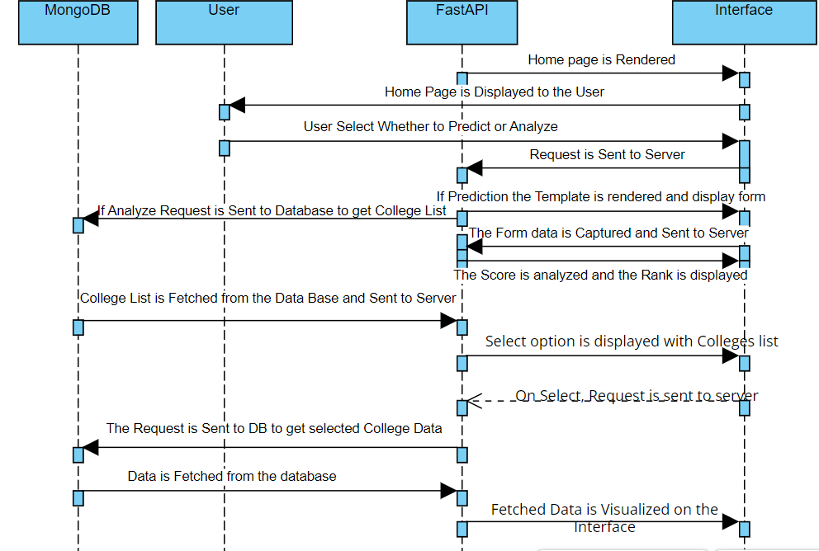
Design

Slide 14
References
“World University Rankings Research Papers.” Academia.edu, https://www.academia.edu/Documents/in/World UniversityRankings. https://www.elsevier.com/research-intelligence/university-rankings-guide.
“Linear Regression — scikit-learn 1.0.2 documentation”, https://scikitlearn.org/stable/modules/generated/sklearn.linear model.LinearRegression.html
NIRF Ranking Dataset https://www.kaggle.com/datasets/apoorvgupta25/nirf- rankings-from-2016-to-2021

Slide 15
Queries …??

Slide 16
Thank You..!

